Slide 1
Group D: RTI Settings Experiment Georgia O’Keeffe Museum
Members:
Anthony Casaretto
Aaron Jauregui
April Mao
Kevin Neal

Slide 2
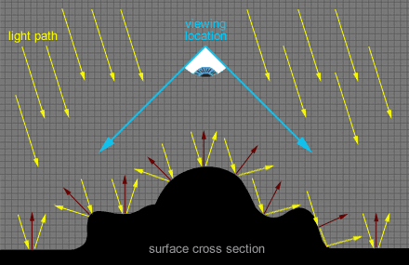
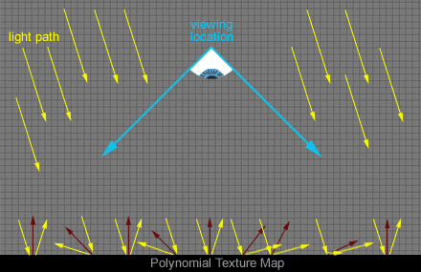
What is RTI?:
The RTI is a software interface to a set of tools that process your captured image set to produce RTI files.
purple arrows : normals of the picture

Slide 3
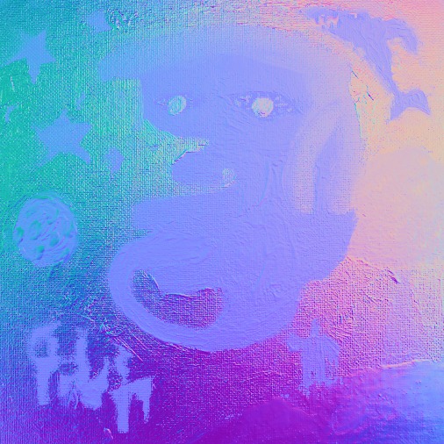
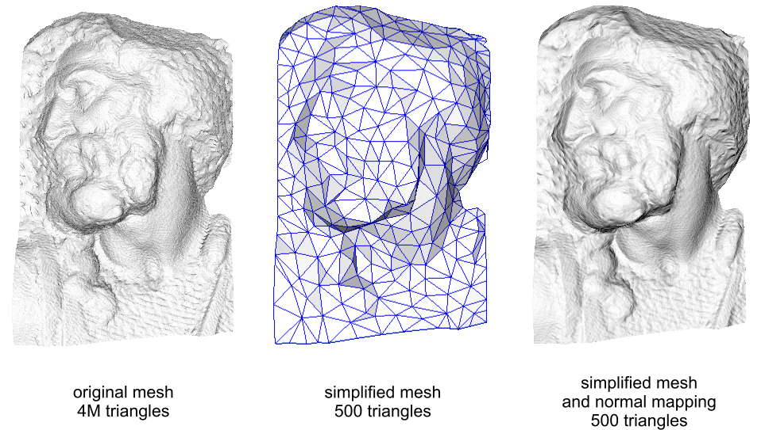
Normal Mapping
A technique used for faking lighting of 3D to 2D image
Normal maps are stored as regular RGB images
Notes:
Add normal map from final set here

Slide 4
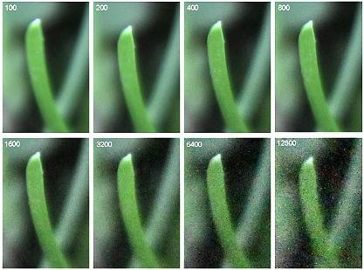
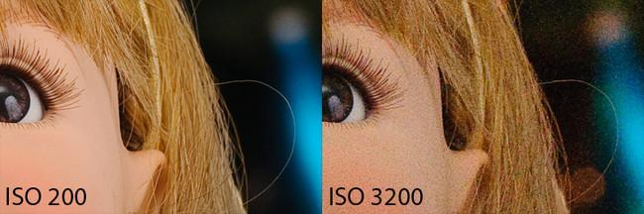
What is ISO?
Film Speed
Higher ISO = More noise/ More sensitive to light

Slide 5
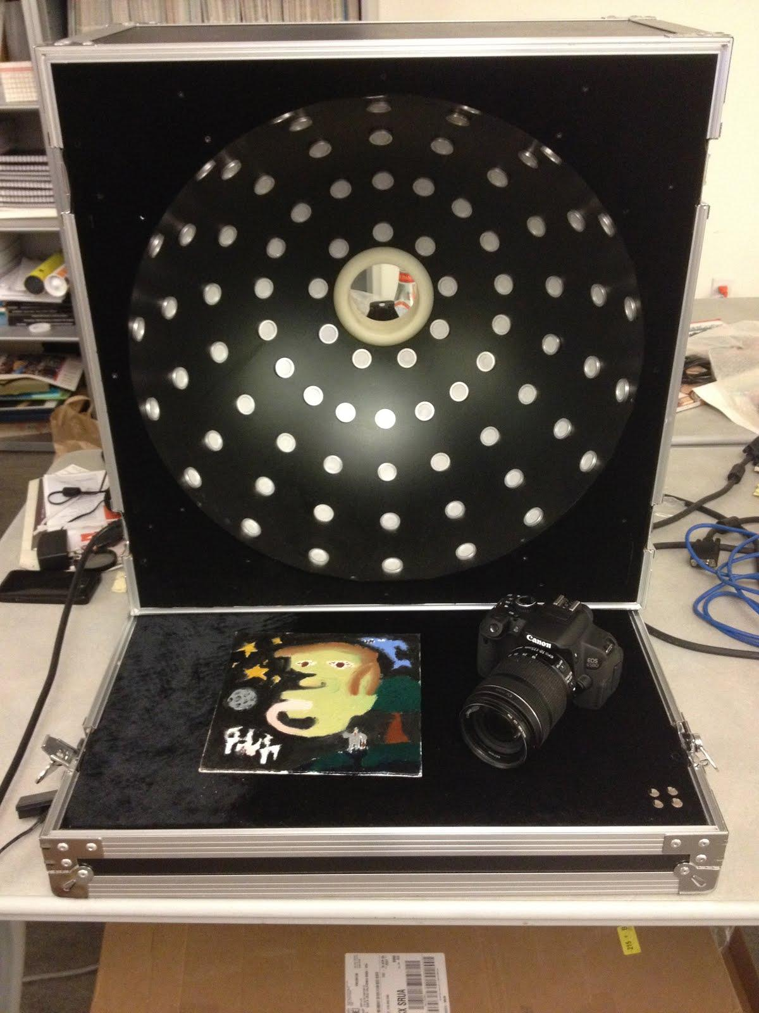
Equipment
Canon EOS 650D DSLR
Light Dome
Test Object

Slide 6
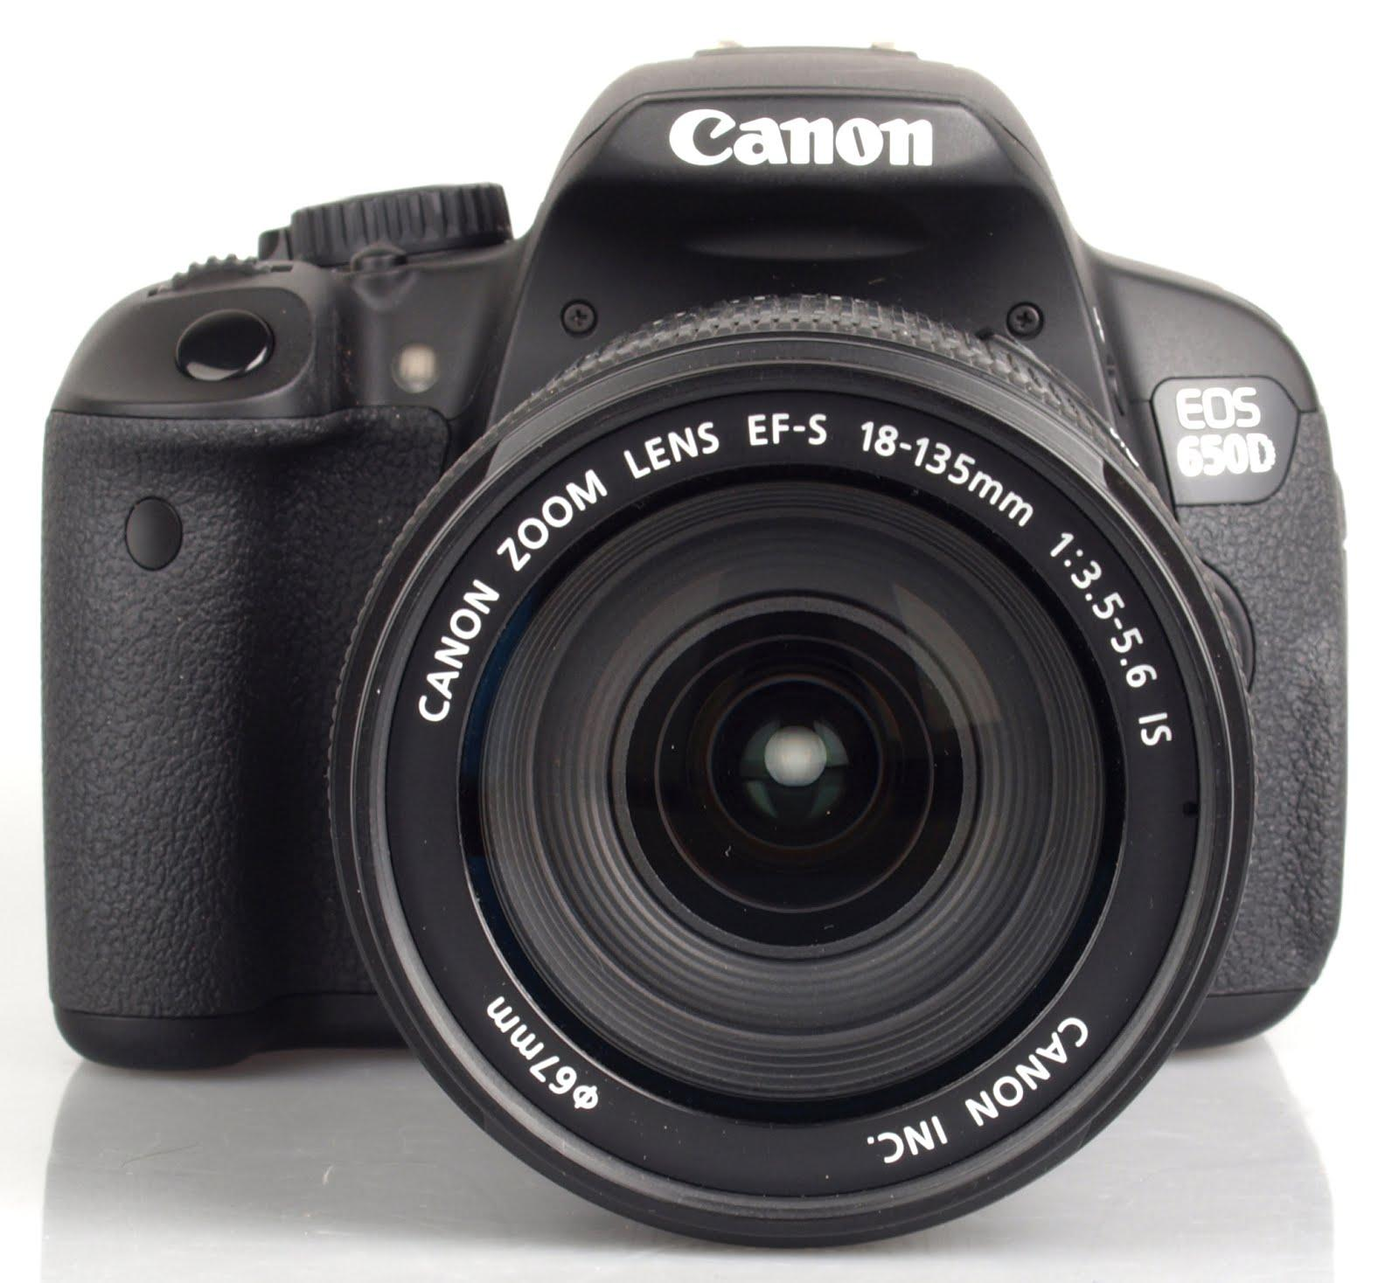
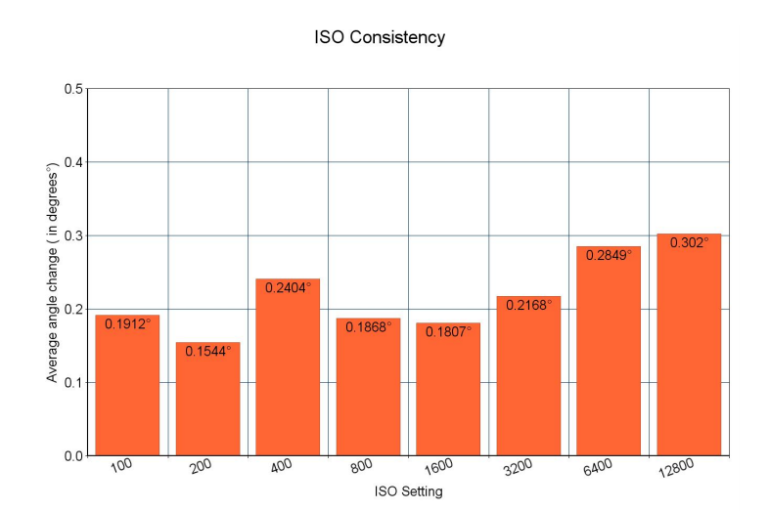

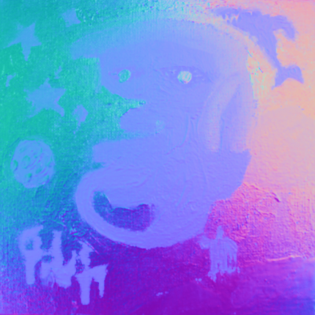
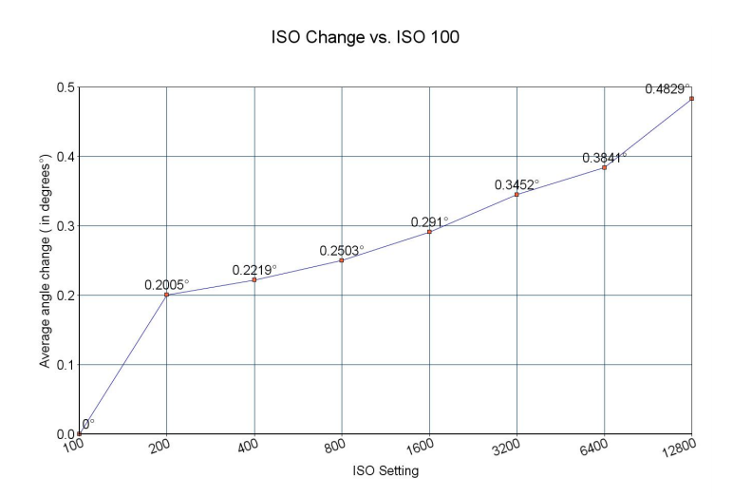

Procedure
Generate normal maps with RTI Viewer
Take pictures:
ISO 100-12800
ISOTEST.m
Run Matlab program on normal map pictures
error between the base ISO average (100) and the averages of the other ISOs
Make Matlab program to compare normal maps

Slide 7
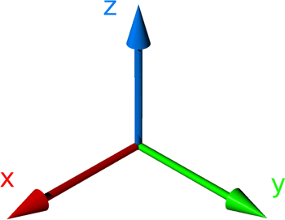
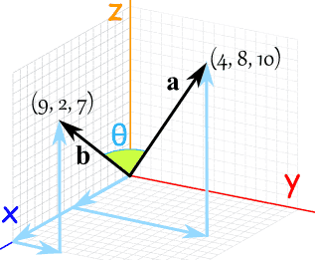
Problems and Solutions
Problem: Compared pixel’s RGB values
Calculate standard deviation
Solution: Compare EACH pixel’s RGB vector angle
Calculate the mean

Slide 8
Low Resolution Results

Slide 9
Low Resolution Results

Slide 10
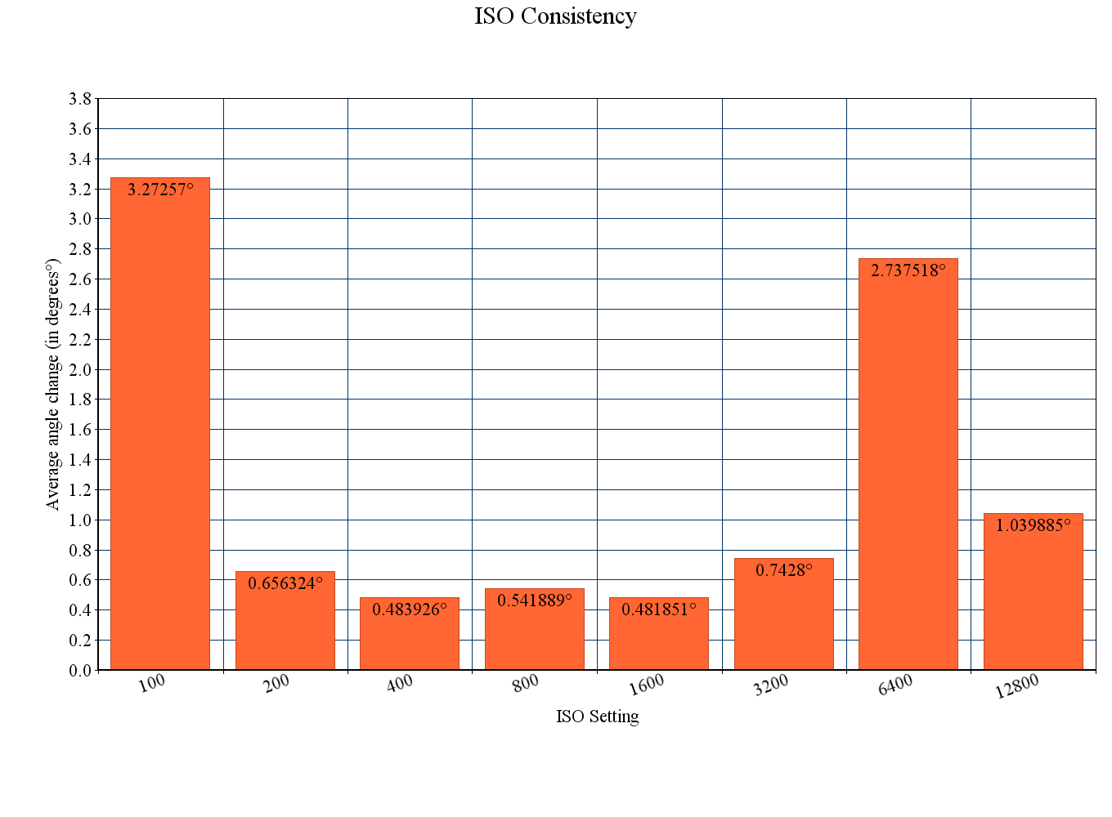
High Resolution Results

Slide 11
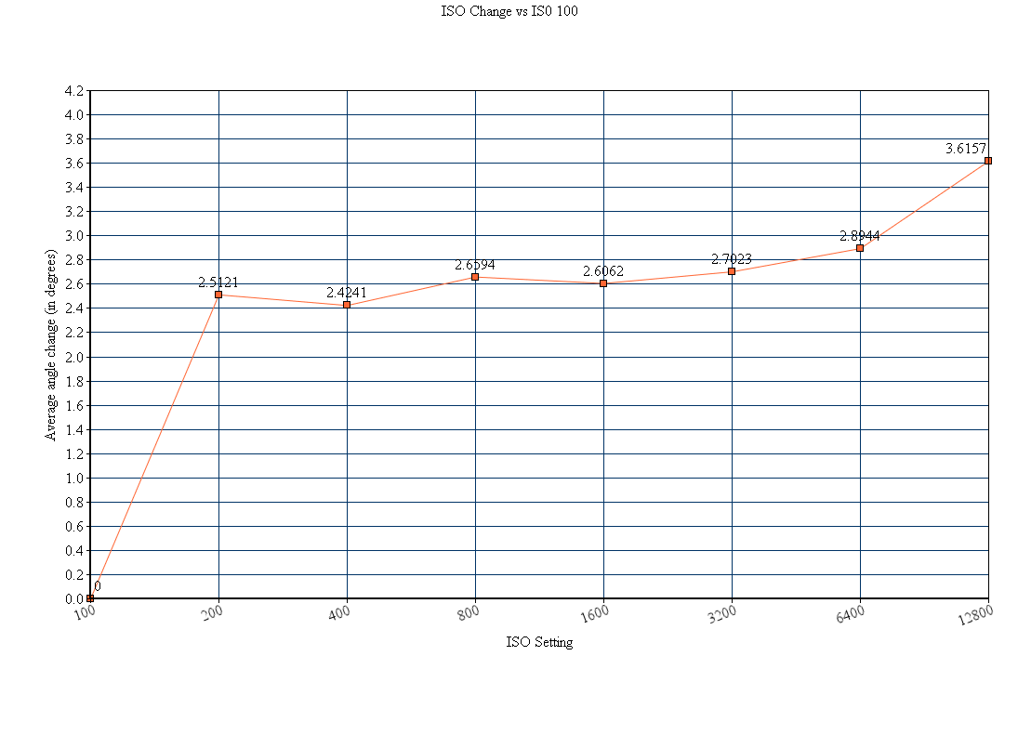
High Resolution Results

Slide 12
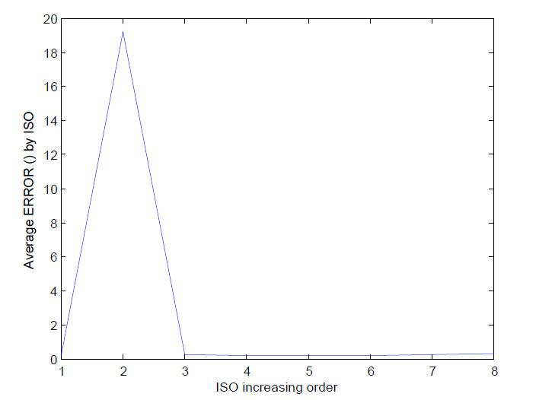
Algorithm Test (Rotate Image)

Slide 13
Conclusion
Higher ISO = Higher error = More noise
More significant at higher resolution
Lower resolution = minimal difference
Higher resolution = relevant difference

Slide 14
To the future user...
New tests to run:
Light distance
Dome distance
Rerun ISO experiment:
Larger domes
Larger/different test objects
Matlab Code - Needs to be optimized

Slide 15
Questions?

Slide 16
Acknowledgements
Thanks to Jing Liu for providing scripts to create the RTI files.
Thanks to Bipeng Zhang for help debugging with MatLab.
Thanks to Cultural Heritage Imaging for the RTI viewer software.
Thanks to Breeze Systems for the open source tool DSLR remote pro.
Thanks to James Davis for being helpful in guiding us during the process of this project.

Slide 17
Tasks
Familiarized ourselves with use of the dome
Took some sample data using different ISO settings; created 2 RTI files for 5 different ISOs. Made note that as we increased ISO, the images not only got brighter, but the normal maps became more grainy.
Got a better test object: small, square, oil painting that should fit inside the dome much better.
Got a decent workflow going using the USB cable; data collection still relatively slow, but good enough for this experiment.
Obtained ISO data set for analysis: tested 8 ISOs, 100, 200, 400, 800, 1600, 3200, 6400, and 12800. Make 5 RTI-viewer files for each ISO.
Worked with FreeMat: Wrote program that compares the normal values for each pixel of the normal maps.
Analyzed and improved the MatLab code to provide more useful plots. Got consistency test working properly.
Obtained a new data set using a longer shutter speed to make for more balance of dark to light ratio in images. Made sure setup would allow us to easily crop the final normal map files.
Started working with MatLab to analyze the data.
Cropped the images from final ISO data set.
Obtained our 2 plots

